Slide 1
Recipe Box

Slide 2
The Problem
Recipes kept on paper can get lost, stolen, or destroyed
Paper recipes are hard to share
Paper recipes sizes are limited in space

Slide 3
The Solution
Electronic databases provide integrity and availability
Search and share features significantly improves recipe collection
Review system can introduce new recipes or ideas

Slide 4
Design/Requirements
Waterfall development method
ASP.Net Webapp following MVC (Model View Controller) design
Integrates with SQL Server
Hosted on Azure Cloud

Slide 5
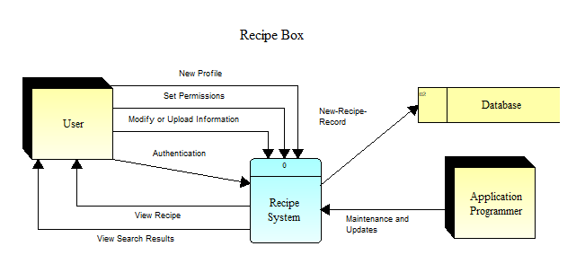
Diagram

Slide 6
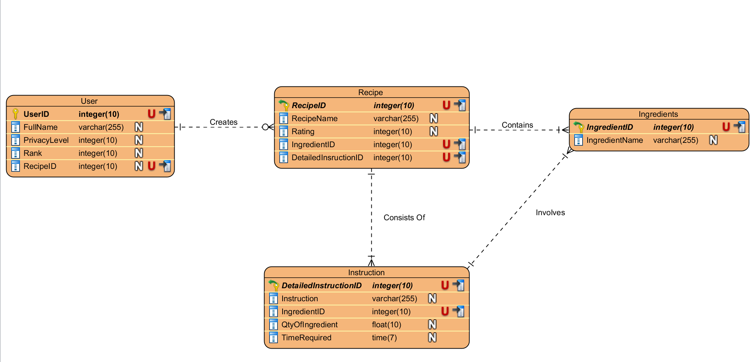
Database

Slide 7
Additional Information
Minimal requirements
Easily tested
Maintenance is accessible
Mobile options are upcoming

Slide 8
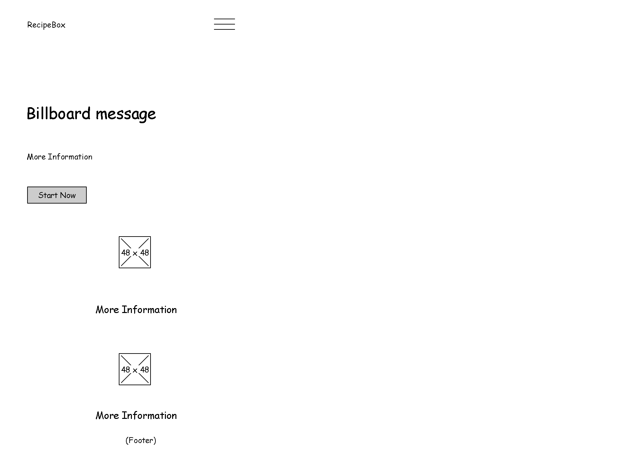
Mobile Wireframe

Slide 9
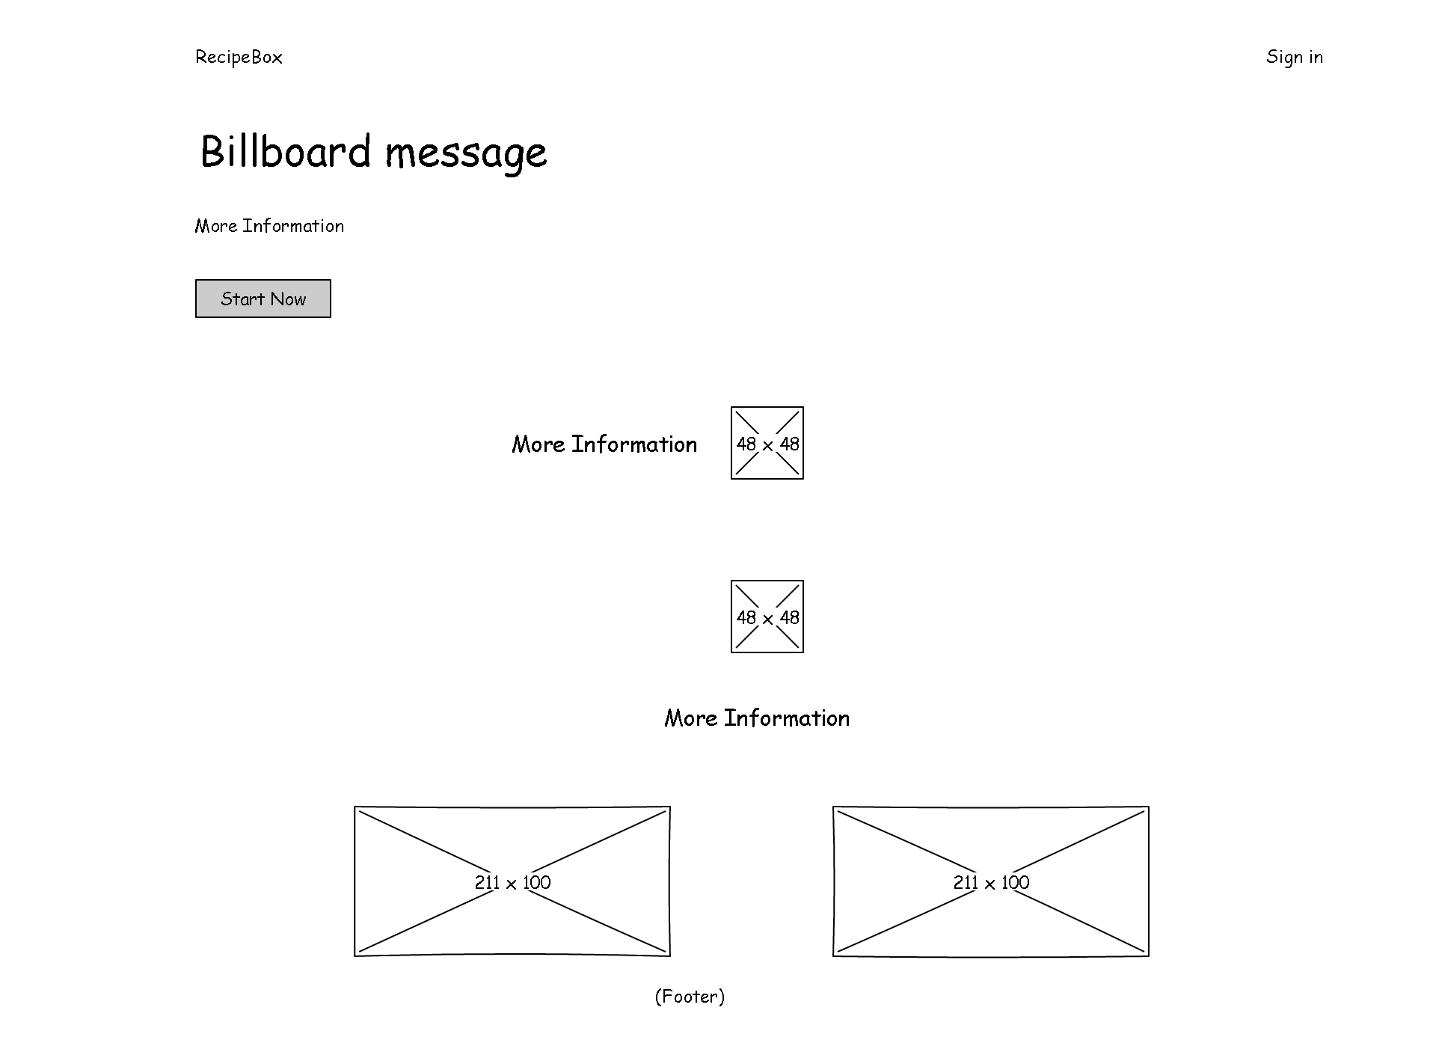
Tablet and Desktop Wireframe

Slide 10
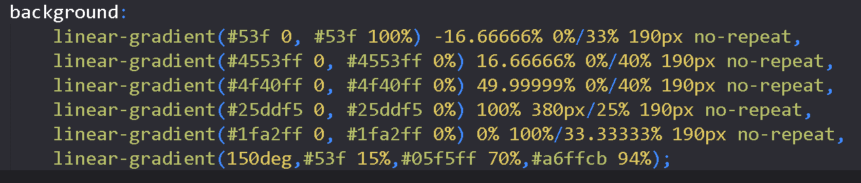
Gradient Theme

Slide 11
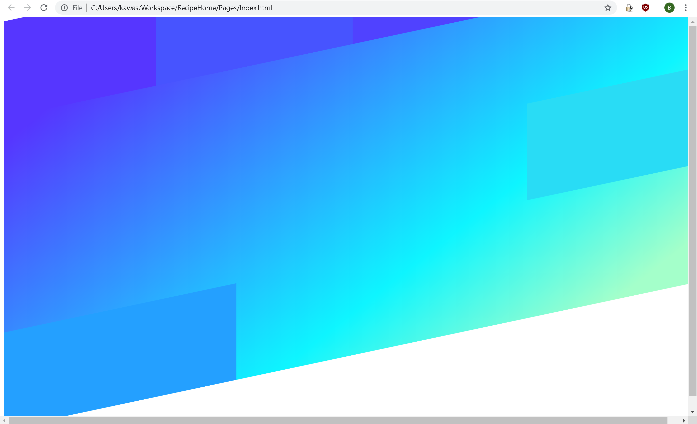
In Browser

Slide 12
Features
Meal Planning and Grocery List
Cross off steps/ingredients
Leave notes/ratings
Search by history, rating, category
Print, email, sharing
Timer
Pin recipes to quick access bar

Slide 13
Similar Apps
BigOven
RecipeScan
25/month
Paprika
$5

